Slide 1
TRANSCENDENTALISM
IN POP CULTURE

Slide 2
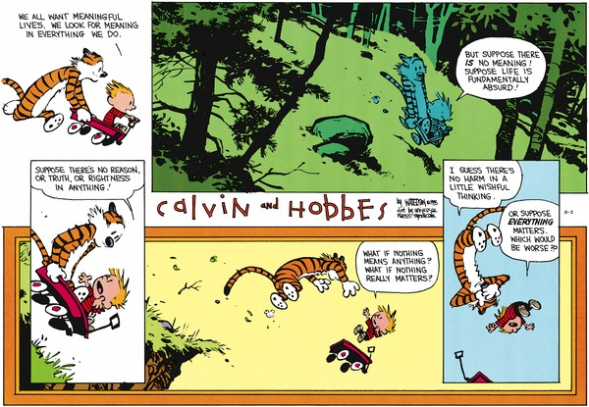

Slide 4
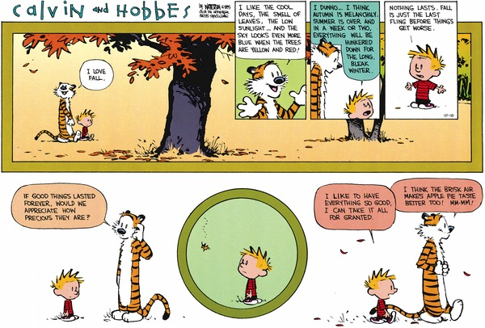

Slide 6
Commercials
https://www.youtube.com/watch?v=B2IaaFz4Fz4
https://www.youtube.com/watch?v=Q5qZedMTkkE
https://www.youtube.com/watch?v=7iZfaep_LS4

