Slide 1
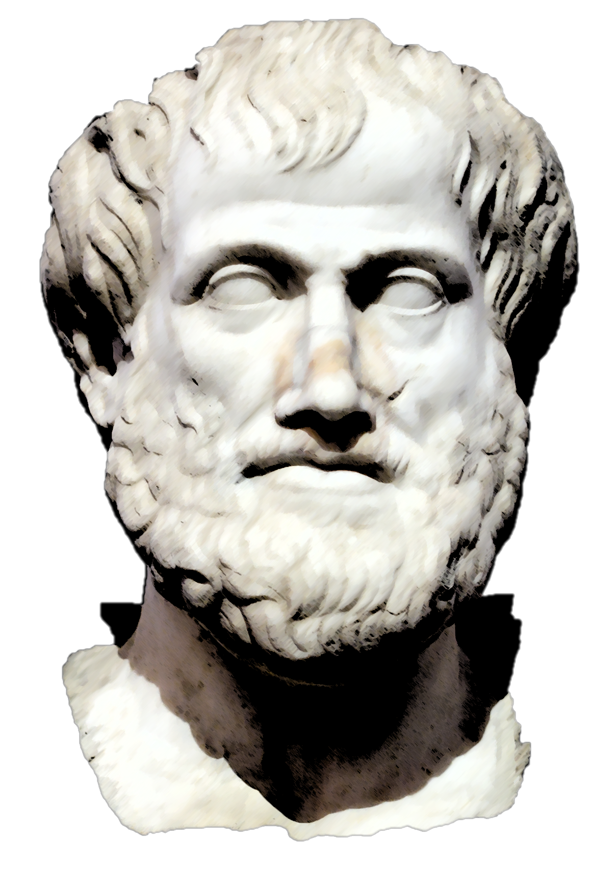
Rhetorical Appeals
ETHOS, PATHOS & LOGOS

Slide 2
What is rhetoric?
The art of using language to persuade, influence beliefs, and achieve a desired purpose
Why must we learn this?

Slide 3
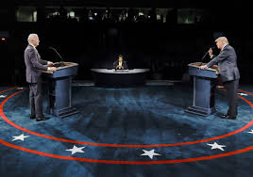
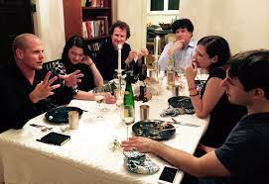
Rhetoric is all around us…
In advertising
In politics
In social interactions
In business transactions

Slide 4
Why learn about rhetoric?
Become an attentive interpreter of the world
Recognize sound arguments vs. empty talk
Write and speak more effectively
Discuss and debate with credibility and confidence

Slide 5
History of Rhetoric
In 4th century B.C., Greek philosopher Aristotle introduced the context for persuasive communication and the three rhetorical appeals
Speaker
LOGOS
PATHOS
ETHOS
Subject
Audience

Slide 6
Logos
An appeal to logic or reason.
Provides audience with facts, evidence and statistics in order to persuade them.

Slide 7
Pathos
An appeal to emotion.
Attempts to evoke an emotional response in the audience, whether positive (joy, relief, etc.) or negative (guilt, fear, etc.)

Slide 8
Ethos
An appeal credibility or morals
Convinces audience that speaker is honest, credible, and/or an authority
Or appeals to audience sense of right or wrong

Slide 9
What are rhetorical appeals?
Persuasive strategies used in arguments to support claims and respond to opposing arguments.
A strong argument uses a combination of the appeals.

Slide 10
PRACTICE
Assess Yourself!
Which rhetorical appeals are being used
in the following advertisements?

Slide 11
Ethos, Pathos, Logos?
Logos

Slide 12
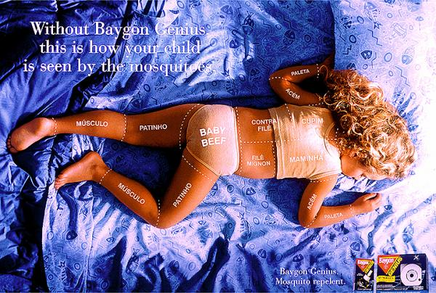
Ethos, Pathos, Logos?
Pathos

Slide 13
Ethos, Pathos, Logos?
Ethos, Logos, Pathos

Slide 14
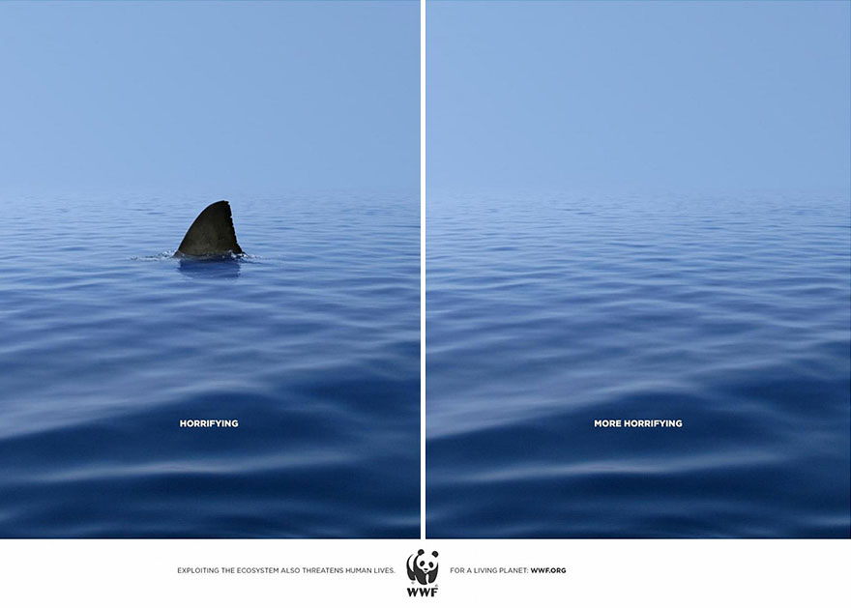
Ethos, Pathos, Logos?
Pathos

Slide 15
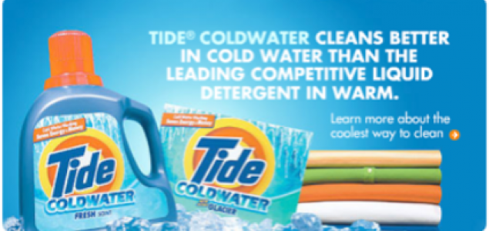
Ethos, Pathos, Logos?
Logos

Slide 16
Ethos, Pathos, Logos?
Pathos, Logos

Slide 17
Ethos, Pathos, Logos?
Pathos, Logos, Ethos

Slide 18
Ethos, Pathos, Logos?
Pathos, Logos

Slide 19
Ethos, Pathos, Logos?
Ethos,
Pathos,
Logos

Slide 20
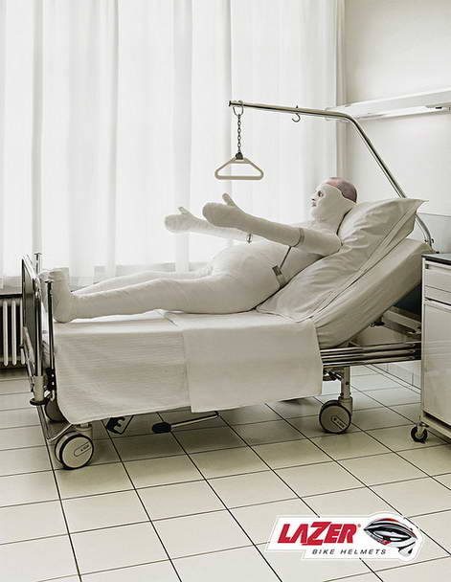
Ethos, Pathos, Logos?
Pathos
Logos

Slide 21
Ethos, Pathos, Logos?
Ethos, Pathos, Logos

Slide 22
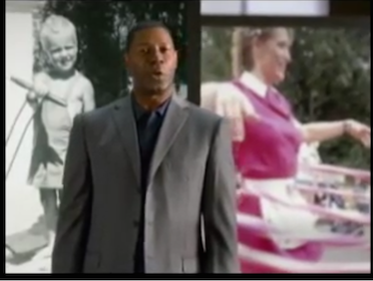
Ethos, Pathos, Logos?
How about in these television commercials?
https://www.youtube.com/watch?v=6HNKqffU3Cc&index=2&list=PLUt_PBZQzj_D7wPfnSX-m9Ho1pfcq_CgG

Slide 23
Watch It!
https://www.youtube.com/watch?v=FeCz5fy02JE&list=PLDnR6PHxO7EfIOTMJvdeVsK0NEwiCeZ3P

Slide 24
Practice: Rhetoric in Speech
Which rhetorical appeals are used in the following excerpts from Martin Luther King Jr.’s “I Have a Dream” speech?
“I have a dream that my four little children will one day live in a nation where they will not be judged by the color of their skin but by the content of their character.”
“I have a dream that one day this nation will rise up and live out the true meaning of its creed: ‘We hold these truths to be self-evident, that all men are created equal.’ ”
Pathos
Logos, Pathos

Slide 25
SALES PITCH
Objective: Make a sales pitch to this wealthy group of investors to finance your product.

Slide 26
ACTIVITIES
Rhetorical Analysis

Slide 27
Rhetoric in Advertising
Find five advertisements (from magazines, television, and/or internet) and describe how each uses ethos, pathos and/or logos to achieve its purpose.
Use provided handout to record your findings.

Slide 28
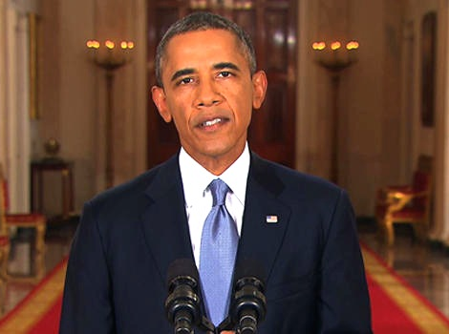
Activity: Rhetoric in Speech
Read the provided excerpts from President Obama’s “Address to the Nation on U.S. Military Action in Syria.”
Identify the rhetorical appeal(s) used in each example.
You can watch the full televised speech here: http://www.americanrhetoric.com/speeches/barackobama/barackobamasyrianation.htm

Slide 29
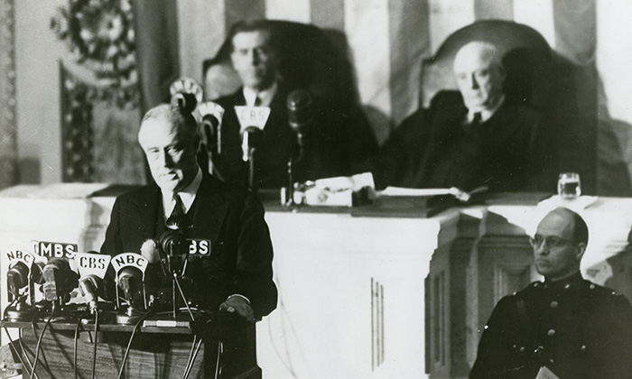
Activity: Rhetoric in Speech
Closely read President Franklin D. Roosevelt’s “Pearl Harbor Address,” underlining examples of ethos, pathos and logos as you read.
Identify the best examples of each appeal on the handout provided.
You can watch the full speech here: https://www.youtube.com/watch?v=YhtuMrMVJDk

Slide 30
Writing Activity
Choose one of the following topics. Write 2-3 well developed paragraphs arguing your stance on that topic. Use AT LEAST ONE of EACH rhetorical appeal to help strengthen your argument.
TOPICS
Can money buy love?
Should video games be considered a sport?
Should school cafeterias be forced to serve only healthy foods?
Do teachers assign too much homework?
Should video cameras be posted in classrooms?
Which is more important: talent or hard work?

Slide 31
Activity: Persuasive Presentation
CHOOSE ONE:
Persuasive Speech or Multimedia Presentation
2-3 minute speech or multimedia presentation persuading your audience to adopt your position on a topic important to you.
Product/Service Pitch and Commercial
2-3-minute sales pitch to potential investors to persuade them to invest in a product or service you developed; must incorporate a 30-second videotaped commercial selling the product or service

Slide 32
Persuasive Presentation
MUST include:
All three rhetorical appeals (ethos, pathos, logos)
Typed transcript of speech or presentation
“Works Cited” page
Example of Multimedia Presentation:
“To This Day,” Shane Koyczan
https://www.youtube.com/watch?v=ltun92DfnPY
Example of Product Pitch: “Mo’s Bows,” on “Shark Tank”
https://www.youtube.com/watch?v=OH3Fy3Q70fg

