Slide 1
The Crucible
The Historical Context

Slide 2
Investigating the Context
Author/Selection | Author’s Purpose | Puritan Beliefs Evident Through the Selection | Connect with Other Works in this Activity
Text #1: Sinners in the Hands of an Angry God
Text #2: The New England Primer
Text #3: The Trial of Martha Carrier
Text #4: The Lesson of Salem

Slide 3
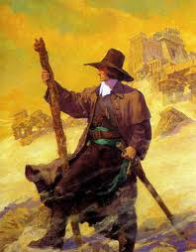
The Puritans
English Protestants that originated in late 16th century
Separatists after Henry XIII separated from the Vatican.
Sought to "purify" the church of England (Anglican church)
England restricted Puritans from practicing their religion by law
New England sect was strongly influenced by Calvinism

Slide 4
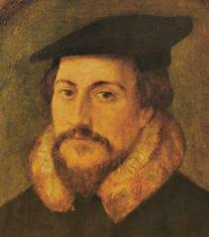
John Calvin (1509-1564)
An influential French theologian and pastor during the Protestant Reformation. He was a principal figure in the development of the system of Christian theology later called Calvinism.

Slide 5
Calvinism: Nature of God
God is Omniscient
& Omnipotent
God is revealed to
man through
theology
God determines
man’s fate (Judge)
God interferes with
the universe as he
sees fit

Slide 6
More Calvinism: Nature of Man
Doctrine of Predestination
Since the fall of
Eden, God has been
Displeased w/ Man
God elects those
whom he wishes
to save
Man can never
atone for his fall
from grace

Slide 7
More Calvinism…
Nature of Life
Evil is an active
Force and should be
destroyed
Suffering is a
necessity
The World is evil

Slide 8
Illuminating Hysteria
Associated Words
Definition
Examples
Hysteria

Slide 9
Interpret a Dramatic Scene in Multiple Ways
How would you interpret John Proctor’s feelings toward Abigail Williams after ACT I?
Proctor is in love with Abigail.
Proctor hates Abigail.
Proctor is afraid of Abigail.
Proctor is conflicted in his feelings for Abigail.

Slide 10
Base your interpretation on…
Lines of Dialogue | Gestures | Movements | Facial Expressions | Vocal Delivery

Slide 11
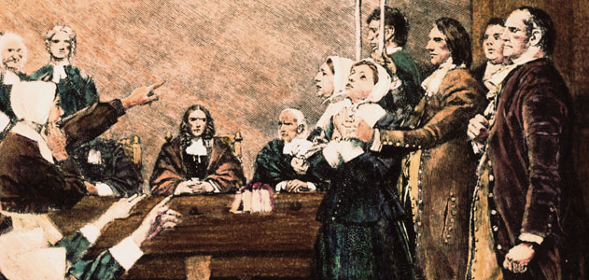
The Salem Witch Trials
Religious Persecution in America

Slide 12
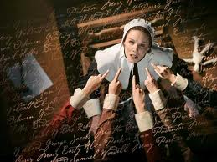
The Witch Hunts
The Salem witch trials occurred in colonial Massachusetts between 1692 and 1693.
More than 200 people were accused of practicing witchcraft—the Devil's magic
20 were executed.

Slide 13
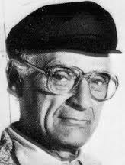
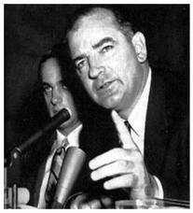
The Red Scare: The 1950s Communist Witch Hunts
Arthur Miller
Senator Joseph McCarthy
McCarthy You Tube Video

Slide 14
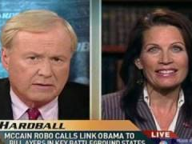
Why study The Crucible???
http://www.youtube.com/watch?v=8bT01mC9xSA&feature=player_detailpage
Aired during the 2008 Presidential Campaign
Michele Bachman was a Republican Candidate for President in 2012

Slide 15
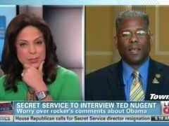
Why study The Crucible???
http://www.youtube.com/watch?v=GNut9BK43kw&feature=player_detailpage#t=143s
Aired 4 MONTHS ago.
Allen West is a United States Congressman

Slide 16
What is so Dangerous about this?
McCarthyism = Political Slander
By accusing the other party of being treasonous or Anti-American—w/o evidence.
Witch Hunts = Personal Slander
By accusing the other person of being sacrilegious or Anti-Christ—w/o evidence.

Slide 17
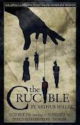
The Crucible: Allegory
Allegories are written in the form of fables, parables, poems, stories, and almost any other style or genre.
The main purpose of an allegory is to tell a story that has characters, a setting that have both literal and figurative meanings.

Slide 18
Characterization
Direct Characterization
The writer makes direct statements about the character’s background, appearance, personality, behavior, and beliefs through narration.
Indirect Characterization
The writer makes indirect statements about the character’s background, appearance, personality, and beliefs through the character’s own
Thoughts
Words
Actions
*And other character’s responses to this character and their thoughts and words about them.

Slide 19
Characters Tracking
1. John Proctor
2. Elizabeth Proctor
3. Abigail Williams
4. Revered Samuel Parris
5. Reverend John Hale
6. Rebecca Nurse
7. Mary Warren
8. Giles Corey
9. Tituba
10. Judge Hawthorne

