Slide 1
THE CRUCIBLE
Literary Analysis Essay
Due Date: Monday, November 26 @ 11:59pm on Turnitin.com

Slide 2
Essay Topic
Writing an argumentative essay is essentially answering a question and engaging in a debate.
Debate: Which of humanities flaws does Arthur Miller highlight as the root cause of the Salem witch trials: ego, jealousy, or conformity?
You must defend your idea/theory (thesis)!
Pick one side of the argument. You are not allowed to sit on the fence.
Create a compelling argument that your reading audience will believe and lean towards.

Slide 3
Introductory Paragraph
Opener/Attention Getter
Extend/Explain the Opener
Too many writers shift too quickly from the broad or abstract opener directly into the assigned topic---DON’T!!!
Let your idea develop. This could go on for 2-3 (or more) sentences if it is interesting.
Connect to the assigned thesis
Establish your Thesis: For this essay, it’s argumentative, so you need to take a stand: is George and Lennie’s relationship mutually beneficial or is it one-sided.

Slide 4
Body Paragraphs
Body Paragraph 1: (Overture/Act 1)
Topic sentence that examines the root cause at the beginning of the play Develop/Support your topic with 2-3 passages/quotes from the text (supporting evidence).
Concluding Sentence
Body Paragraph 2 (ACT 2 & 3)
Topic sentence that examines the root cause through the rising action of the play Develop/Support your topic with 2-3 passages/quotes from the text (supporting evidence).
Concluding Sentence
Body Paragraph 3 (ACT 4)
Topic sentence that examines the effects of ego, jealous, or conformity by the conclusion of the play Develop/Support your topic with 2-3 passages/quotes from the text (supporting evidence).
Concluding Sentence
Note: Organizing your essay chronologically will enable you to show the growth of the root cause as it creates more tension within the environment of the play and the characters.

Slide 5
Show a Progression in the theme
Overture & Act 1: the seeds of jealousy, ego, or conformity have been planted and have been ruminating for some time.
Act 2 & Act 3: Point-of-No-Return. Hysteria is at its full height due to jealousy, ego, or conformity.
Act 4: Devastation report. Show the devastation and havoc caused by jealousy, ego, or conformity.

Slide 6
Topic Sentences for each body ¶
Must align with thesis
Should not be a quote
Should not include a specific detail or example
Should use transitional words
Should indicate the topic of that paragraph
Examples:
Body ¶ 1: In the exposition of The Crucible, Miller leaves a subtle trail of bread crumbs hinting that jealousy is the root cause of the coming hysteria.
Body ¶ 2: As the story progresses, the mounting jealousies between characters are the sole reason for the madness in Salem.
Body ¶ 3: During the final moments of the play, the playwright unveils jealousy’s destructive path.

Slide 7
Quotation Format
BLEND QUOTATIONS
Introduce the quote/passage
Set the scene: Parris is jealous of Proctor’s reputation, and this is evident when Parris reveals that “ ” ( ).
Citations
Include page number in parenthesis after the “ ”
? and ! place inside the “ ”
Explain the quote
Provide an explanatory analysis of the quote.
Do NOT translate the words of the speaker
The objective is to explain the significance of the quote and how it shows the root cause. You chose this quote to prove your thesis, so explain how it emphasizes/highlights your theory about The Crucible.

Slide 9
Concluding Sentences for each body ¶
The concluding sentences…
Should not include a specific detail or example
Should not be a quote
Should not be the explanation of a quote
Each paragraph should end with a concluding sentence that…
Example: Thus, it is apparent in the exposition of the play that Miller is showing the audience that jealousy is the main motivator for character action.
Circles back to summarize the main point of the paragraph.
Aligns with the thesis statement.
Wraps up the paragraph with a nice neat bow
Note: Topic and concluding sentences provide a road map for readers and add consistency.

Slide 10
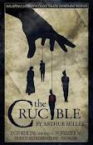
The Crucible: Allegory
Allegories are written in the form of fables, parables, poems, stories, and almost any other style or genre.
The main purpose of an allegory is to tell a story that has characters, a setting that have both literal and figurative meanings.
Examples:
The Tortoise and the Hare from Aesop’s Fables: From this story, we learn that the strong and steady win the race.
The Hunger Games: This trilogy of young adult books is an allegory for our obsession with reality television and how it numbs us to reality.

Slide 11
Conclusion
Restate Thesis
Evaluate: Quick comprehensive review of the characters who display this flaw and how they affect the outcome of the play.
Extend: Based on the story and the characters, what is Miller’s position with regards to humanity’s flaw of ego, jealousy or conformity?
Clincher:
A final sentence that may reinforce an overall argument or leave the reader with a memorable and striking thought.
Meet the reader’s needs by ending an argument on a complex topic in a clear, straightforward way.

Slide 12
MLA Format
UTILIZE CLASS WEBSITE: http://triveng.weebly.com/mla.html
1” margins
12-point font & Times New Roman
Entire document double spaced
Indent ¶s
Header with name, teacher, class, & date
Appropriate title (not the name of the assignment): must be clever and contain the title of the novel and the author.
Ex. Getting to the Heart of the Problem: Jealousy in Arthur Miller’s The Crucible
Title of The Crucible in italics

Slide 13
In-text Citations & Works Cited
In-text Citations
Page numbers after quotes in ( )
Appear at the end of the sentence before the period
Only first ( ) must contain author’s last name ie. (Miller 1112).
Works Cited Page Sources
If essay ends on page 3, then the Works Cited is on page 4
Sources:
The Crucible (Work in an Anthology)
Article: Lucifer Effect, “Self-Esteem, or Self Importance,” or “How Jealousy Works” (Online Articles)
Sample Works Cited Page: https://owl.english.purdue.edu/owl/resource/747/12/

Slide 14
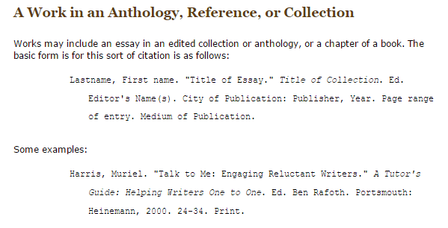
Works Cited
How to cite The Crucible
Use the literature book to complete citation

Slide 15
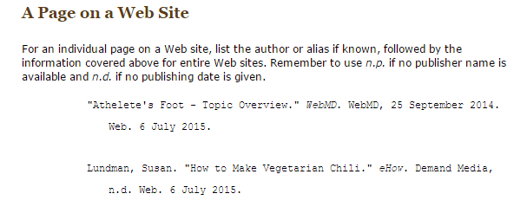
Works Cited
How to cite informational sources
Use the website link on the handout to complete citation

Slide 16
Other Writing Tips
No first or second person (I, me, my, we, us, you, your). Third person only.
NO: Thus, I believe that the root cause of the Salem Witch Trials and the madness that griped this community is jealousy.
YES: Thus, the root cause of the Salem Witch Trials and the madness that gripped this community is jealousy.
Write in present tense
No: Mary followed Abigail and the other girls in order to fit in and to feel self-important.
YES: Mary follows Abigail and the other girls in order to fit in and to feel self-important.

