Slide 1
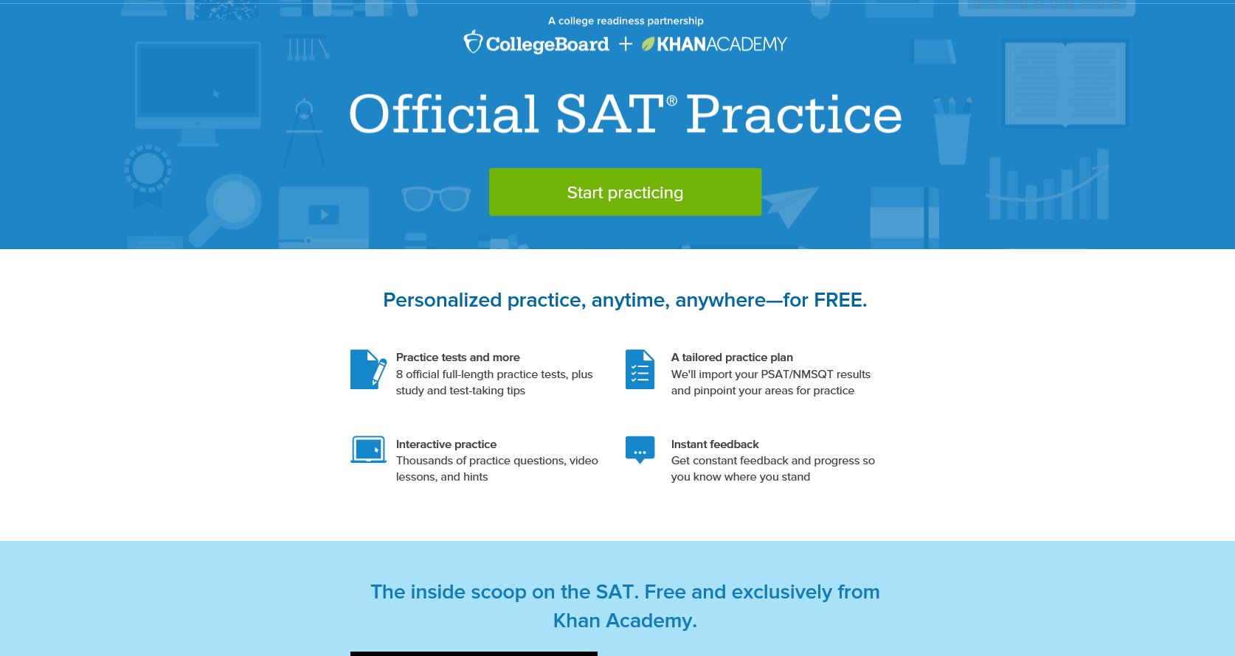

Slide 2
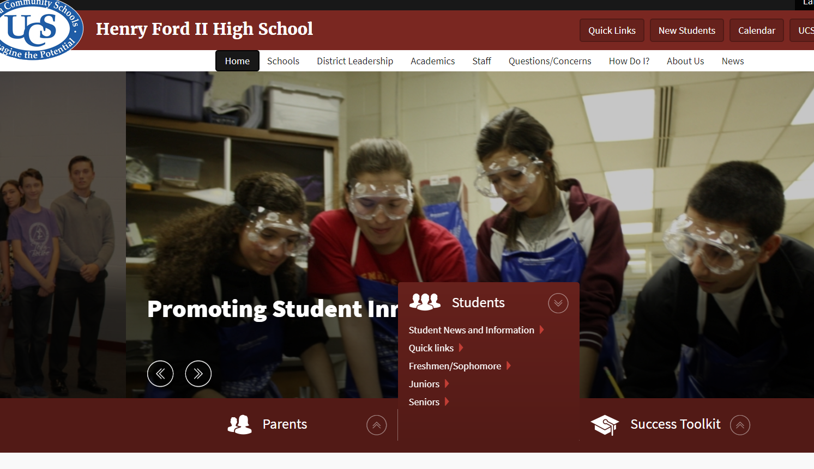
Linking Score and Khan Academy
Go to HFII website (ford.uticak12.org) and click on students and Juniors or Seniors

Slide 3
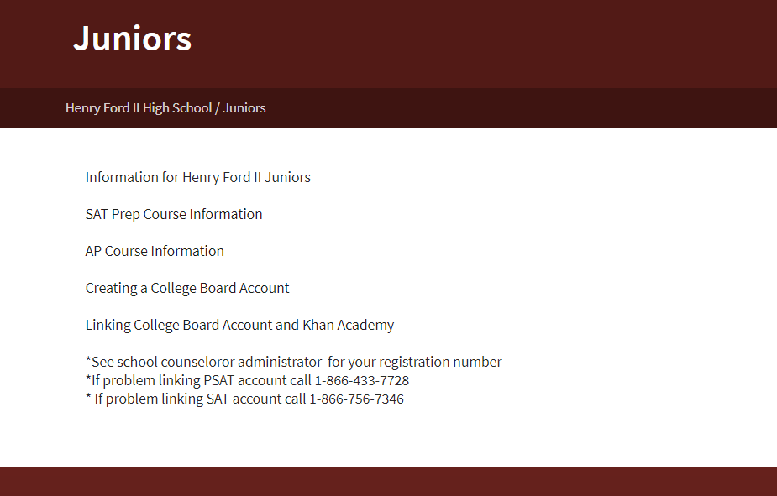
Creating a College Board Account
Click on Create a College Board Account and follow steps

Slide 4
Linking College Board and Khan Academy
Once you have a CollegeBoard account created then click on Linking College Board Account and Khan Academy and follow steps

Slide 5
Practicing in Khan Academy

Slide 6
Benefits of free practice

